Slide 1

Lecture 1.
Optimization and electronic structure
Prof. Kun-Han Lin (林昆翰助理教授)
Department of Chemical Engineering,
National Tsing Hua University, Taiwan
2022 Fall | Gaussian Tutorial

Slide 2
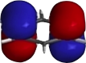

Common workflow in computational chemistry
c1ccccc1
Structure
Generation
Molecular
Properties
Geometry Optimization
Avogadro,
Chemdraw,
Openbabel,
…
DFT, WF-based method, semiempirical, forcefield…
Electronic structure method needed

Slide 3
What is molecular geometry?
3D structure or arrangement of atoms in a molecule
Why is it important?
Electronic structure depends on the geometry
Properties depend on the electronic structure
What is the most representative geometry?
VSEPR
The one with the lowest energy

Slide 4
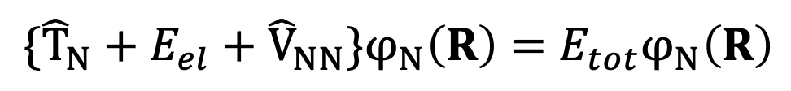
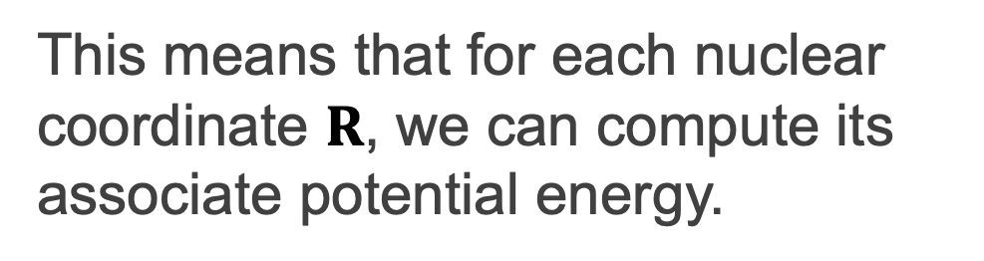
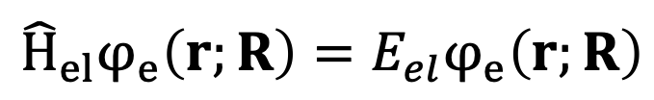
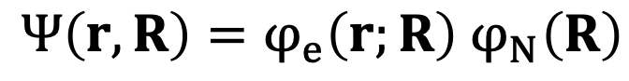
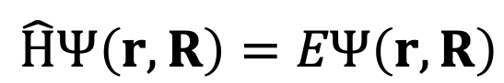
Potential energy surface
Under Born-Oppenheimer approximation:
$$\hat{H}Ψ\left(r, R\right)=EΨ\left(r, R\right)$$
Schrödinger equation
$Ψ\left(r, R\right)=φ_{e}\left(r;R\right)$ $φ_{N}\left(R\right)$
$${\hat{H}}_{el}φ_{e}\left(r;R\right)=E_{el}φ_{e}\left(r;R\right)$$
$$\{{\hat{T}}_{N}+E_{el}+{\hat{V}}_{NN}\}φ_{N}\left(R\right)=E_{tot}φ_{N}\left(R\right)$$
This means that for each nuclear coordinate $R$, we can compute its associate potential energy.

Slide 5
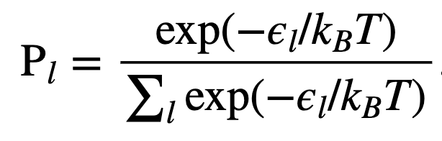
Geometry optimization: what and why?
Ground state minimum
Geometry with lowest energy in ground state
Most stable and representative
Statistical mechanics
Boltzmann factor
Several local minimum
Conformational isomers (examples?)

Slide 6
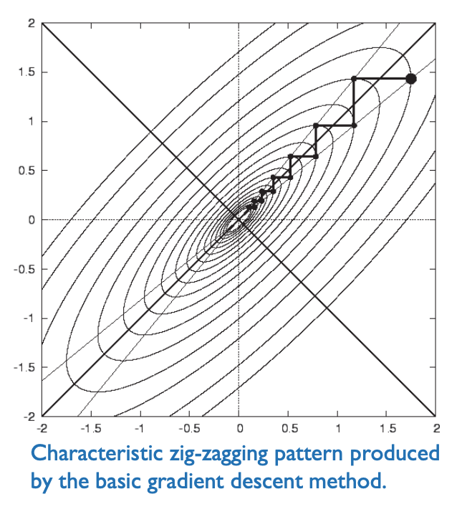
Geometry optimization: how?
Optimization problem
Finding global minimum
But often, we stuck at local ones
Algorithms
Steepest descent, conjugate gradients, BFGS
Overcome local minimum
Simulated annealing

Slide 7
Electronic structure method
What is electronic structure?
The probability distribution of electron in the system.
The molecular orbitals
And the associated energies (energy levels of MOs)
The band structure and the density of states (crystals)
Why is it important?
It determines the molecular properties
Explains the chemistry

Slide 8
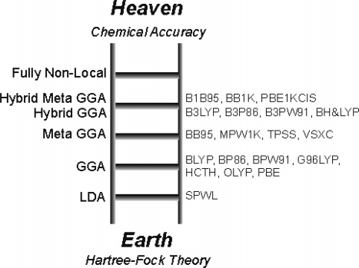




Methods and software
GAUSSIAN 16
But accuracy doesn’t always improve with increasing cost…

Slide 9
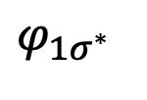
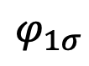
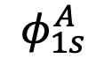
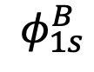
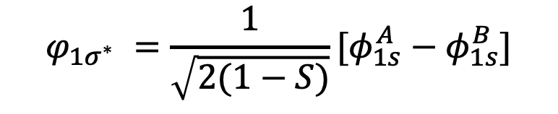
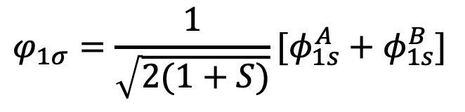
Examples: why He₂ is not stable
$$φ_{1σ^{∗} }$$
Linear Combination of Atomic Orbitals
(LCAO)
$$φ_{1σ}=\frac{1}{\sqrt{2(1+S)}}[φ_{1s}^{A}+φ_{1s}^{B}]$$
constructive interference
$$φ_{1s}^{A}$$
$$φ_{1s}^{B}$$
$$φ_{1σ^{∗} }=\frac{1}{\sqrt{2(1−S)}}[φ_{1s}^{A}−φ_{1s}^{B}]$$
destructive interference
$$φ_{1σ}$$

Slide 10
Bonding and anti-bonding orbitals

Slide 11
Examples: HOMO, LUMO and HOMO-LUMO gap
MO energy matters!
Otherwise electron/hole separation won’t occur
If HOMO-LUMO gap too large, no absorption
MO distribution matters!
Less likely to recombine
Easier to transfer

Slide 12
J. Mater. Chem. A, 2018, 6, 14518

Slide 13
Hands-on: electronic structure and molecular properties
Learning Goal
Construct an initial molecular structure using Avogadro.
Perform geometry optimization for H₂ and benzene.
Visualize their molecular orbitals (MOs).

Slide 14
Introduction to our cluster
Login our cluster
Use Mobaxterm
ssh -Y [username]@[our ip]
Home folder
A default login folder
/home/[username]
-Y to enable Xwindow (for graphical purpose)

Slide 15
Environment modules
Modules that load required libraries and compilers
Check available modules: module ava
Load a specific module: module load [modulename]

Slide 16
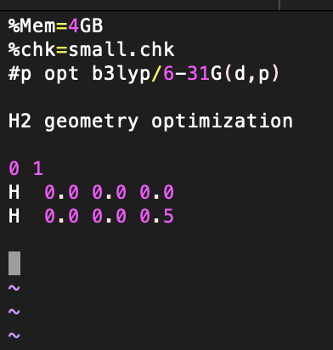
Gaussian input
A .com file
specify required memory
specify the .chk file name
keywords (tell G16 what to do)
Title (arbitrary)
charge spin_multiplicity
element_symbol x y z

Slide 17
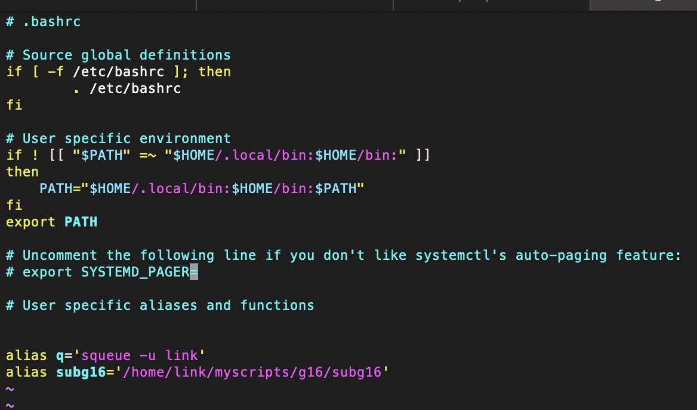
Submission script
vi ~/.bashrc
add a line into this file
alias subg16=‘/home/link/myscripts/g16/subg16’

Slide 18
Submit the jobs
subg16 -p 2 –m 10000 [name].com
squeue
Submit the job
Check the status of your job

